Slide 1
Decarbonization Dynamics
A Multi-Dimensional Story of Global CO2 Emissions
ALOK SALI (46854973) Final Individual Project • Data Visualization • Summer 2026 Live App: https://dataviz-final-project-alok-sali-46854973.streamlit.app/ GitHub: https://github.com/Alok-LOKI/dataviz-FINAL-PROJECT-ALOK-SALI-46854973

Slide 2
Project Overview & Methodology
Dataset Sourced: Our World in Data (OWID) CO2 & GHG Emissions dataset. A rich, high-fidelity real-world dataset covering historical variables globally.
Analytical Focus: Examining shifts in absolute regional emissions, decoupling pathways (GDP vs CO2 per capita), and energy transition structures.
Visual Standards: Plotly-exclusive figures incorporating CVD-safe color mappings, clear takeaway-oriented titles, direct annotations, and decluttered layouts.
Analysis Notebook: An structured Python notebook containing data loading, exploratory analysis, and 10 detailed publication-ready figures.
Interactive Dashboard: A Streamlit web application showcasing a curated interactive set of the findings with dynamic sidebar controls and tabs.
Core Conclusions: Evidence shows successful decoupling of emissions and economic growth in developed countries, but rising absolute volumes in developing regions.

Slide 3
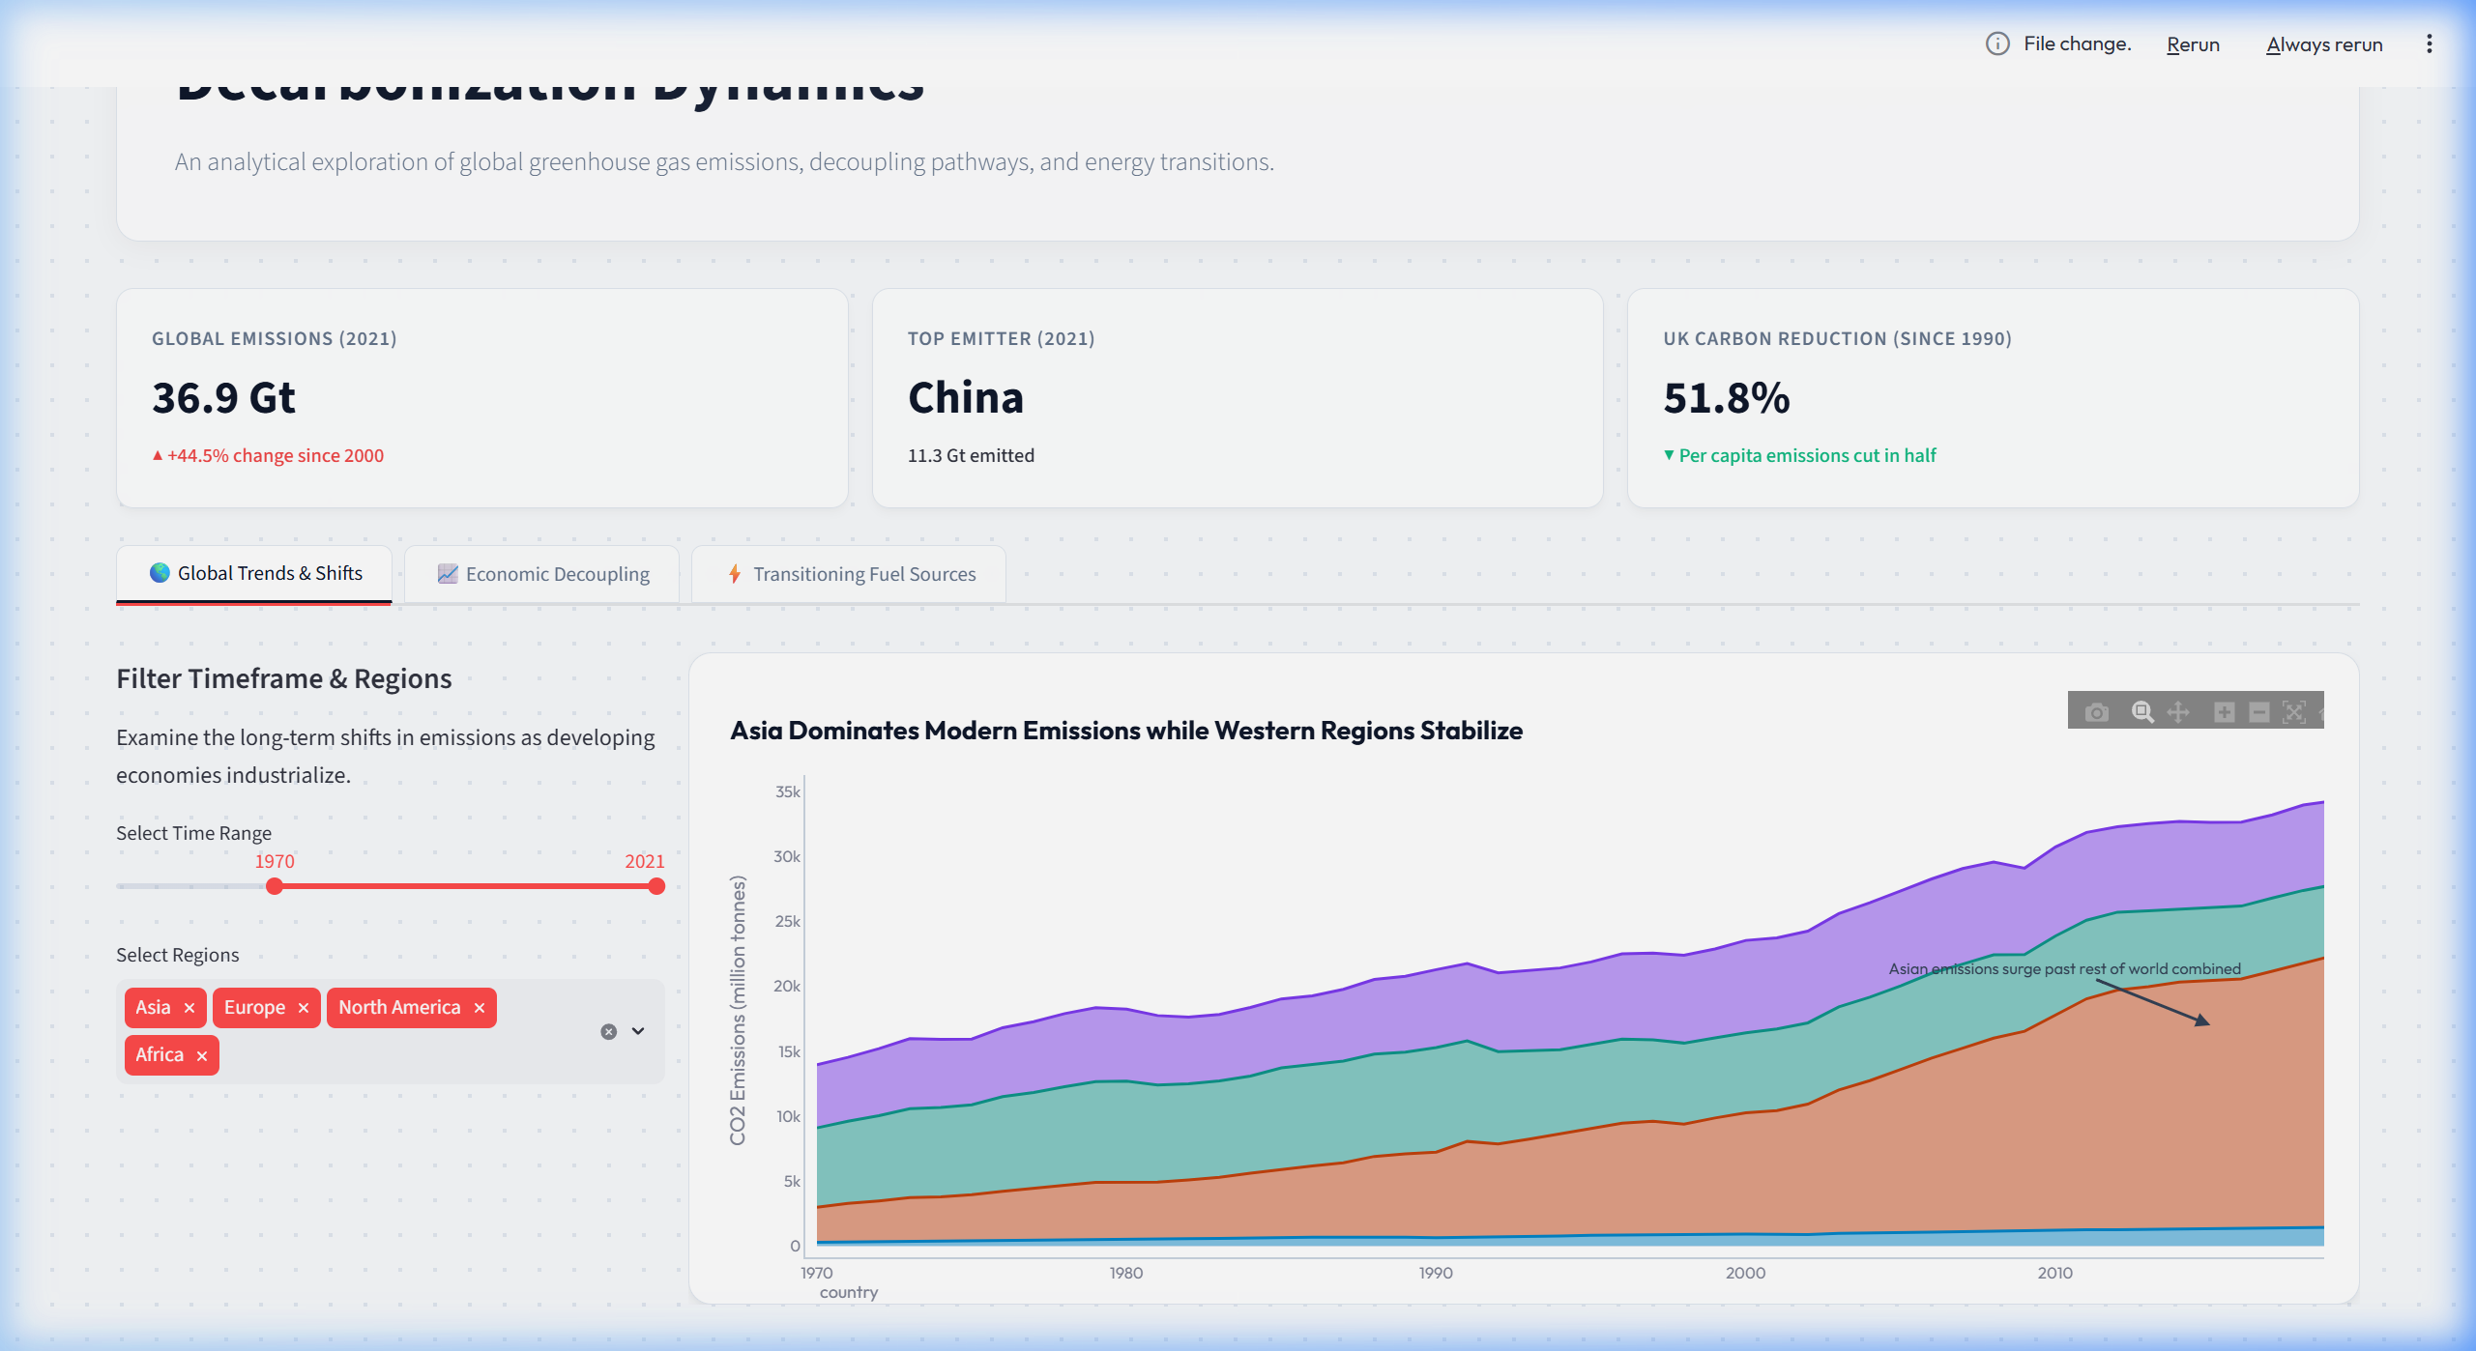
1. Global Shifts: The Rise of Asian Emissions
Historical Context: For over a century, North America and Europe produced the vast majority of industrial CO2 emissions.
Modern Shift: Since 1970, Asian emissions have expanded exponentially to support rapid industrialization and population growth.
Current State: Asia now contributes more annual emissions than the rest of the world combined, while Western regions have stabilized and begun a slow decline.

Slide 4
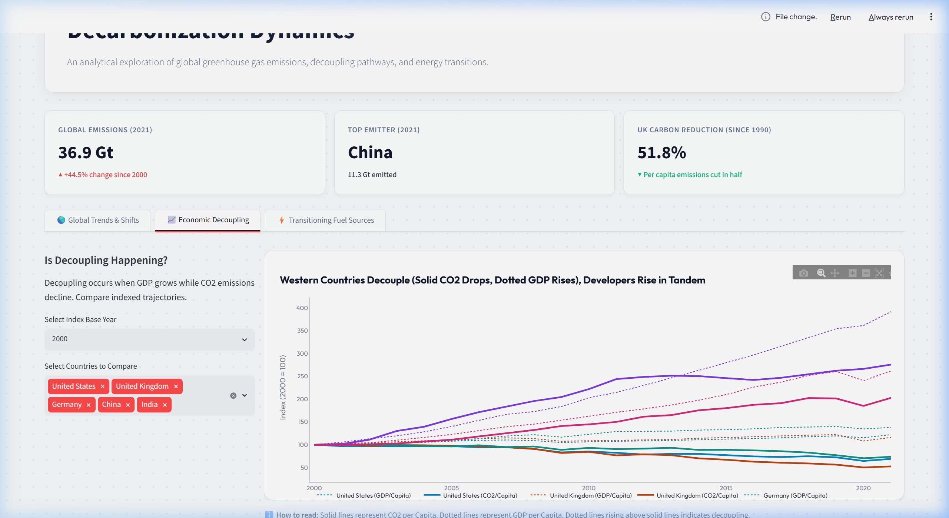
2. Economic Decoupling: G7 vs. BRICS
Western Decoupling: Major G7 economies (e.g., USA, UK, Germany) show clear 'decoupling' post-2000. GDP per capita grows (dotted lines) while CO2 per capita falls (solid lines).
Leapfrog Potential: Developing nations show rising emissions in tandem with wealth, but present opportunities to transition directly to clean energy systems.
Visual Analysis: Normalizing to base index (2000 = 100) displays this divergence clearly.

Slide 5
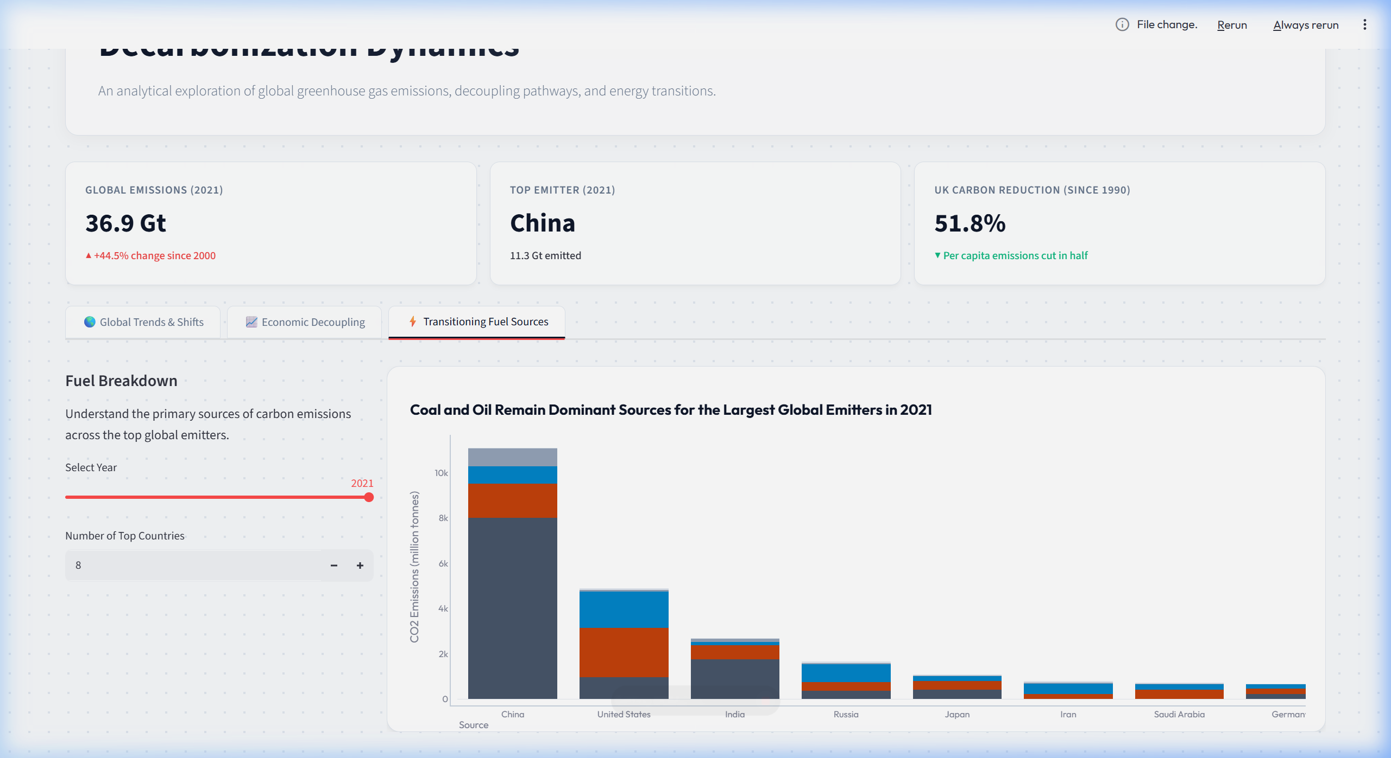
3. Fuel Breakdown & Resource Transitions
Dominant Resources: Coal and Oil remain the leading drivers of absolute emissions for the top 10 global emitters.
Coal Dependency: Nations like China and India have a highly coal-dominated emission profile due to heavy reliance on coal power plants.
Gas Transition: Developed nations have significantly reduced coal emissions by switching to natural gas as a bridge fuel, alongside renewables.

Slide 6
Interactive Dashboard Architecture
Sleek Dark Theme: Designed with a radial dot-grid pattern and responsive glassmorphic widgets to deliver a premium user experience.
Dynamic Filters: Users can toggle years, regions, and select specific countries to recalculate variables and index indices dynamically.
Hybrid Layout: Charts are nested inside high-contrast white container boxes to maintain maximum visual clarity and standard compliance.

Slide 7
Conclusions & Key Takeaways
1. The Decoupling Proof: Economic development no longer strictly requires increasing carbon emissions. Policies, renewable investments, and efficiency upgrades have successfully bent the curve in major developed nations.
2. Asia's Central Role: Global decarbonization cannot occur without support for industrial transition in Asia. Providing technology sharing and capital to help developing economies leapfrog coal is critical.
3. Storytelling with Data: Combining structured exploratory analysis (notebook) and dynamic, customer-facing delivery (dashboard) ensures insights are clear, compelling, and actionable for decision-makers.

